Slide 1

Capstone Project 1 Heart Disease Detection using classification Algorithm
Team Members
T160500117:- Yash Harne
T160500138: Sumedh Wahurwagh
T160500122:- Mohd Shirjil Kamran
T160500130:Rutuja Kharode
T160500106:- Shivani Bhusare
T160500134:-Samiksha khandare

Slide 2
Table of Contents
Problem Statement
Overview of the Project
Data generation & Loading
Data Exploration & Understanding
Exploratory Data Analysis
Data Preprocessing & Feature Engineering
Model Building & Training
Model Evaluation & Performance Analysis
Conclusion

Slide 3
.
Problem Statement
Heart disease is one of the leading causes of death worldwide. Early and accurate detection through diagnostic screening can significantly improve patient survival rates and reduce healthcare costs.
This project aims to build machine learning models that predict the presence of heart disease based on patients’ demographic, clinical, and diagnostic test data, enabling healthcare professionals to make timely and informed decisions. .

Slide 4
Overview of the project
This project predicts whether a person is at risk of heart disease using machine learning classification
algorithms based on medical parameters such as age, blood pressure, cholesterol, heart rate, chest
pain type, and other health indicators.
The dataset contains both numerical and categorical features, with preprocessing steps including handling missing values, encoding categorical variables, and feature scaling.
A complete ML pipeline is built, including data preprocessing, feature encoding, feature scaling, train-test split, and training classification models such as Logistic Regression, Decision Tree, Random Forest, and Support Vector Machine (SVM).
Model performance is evaluated using metrics such as Accuracy, Precision, Recall, F1-Score, and Confusion Matrix, with the best-performing model selected for prediction.
The solution helps in the early detection of heart disease, enabling timely medical intervention, improving patient care, and supporting healthcare professionals in decision-making.

Slide 5
Data generation & Loading
Dataset Source: Kaggle Heart Disease Dataset (UCI Machine Learning Repository)
Dataset Size: 918 patient records (or write the actual number from your dataset)
Target Variable: Heart Disease (0 = No Disease, 1 = Heart Disease)
Features Include:
Demographic details (Age, Sex)
Clinical measurements (Resting Blood Pressure, Cholesterol, Fasting Blood Sugar)
Cardiac test results (Resting ECG, Maximum Heart Rate, ST Slope)
Medical symptoms (Chest Pain Type, Exercise-Induced Angina, Oldpeak)
Data Loading: Dataset is stored in CSV format and loaded using the Pandas library in Python.
Required Libraries: Pandas, NumPy, Matplotlib, Seaborn, Scikit-learn.

Slide 6
Data Exploration & Understanding
Loaded the Heart Disease Dataset using the Pandas library.
the dataset by checking shape, columns, and data types.
Identified missing values and duplicate records to ensure data quality.
Generated statistical summary (mean, median, standard deviation, etc.) using describe().
Defined input features (X) and target variable (HeartDisease) for model training.
Data Analysis: The dataset was explored by checking data types, missing values, duplicates, and statistical summary before model training.

Slide 7
Exploratory Data Analysis
• Histograms: Show feature distributions (temperature, pressure, etc.)
• Correlation Matrix: Finds relationships among variables
• Scatter Plots: Reveal how settings affect production
• Key Insights:
• Shorter cycle times → higher output
• Higher operator experience → better performance
• Cooling time balance: speed vs. quality trade-off

Slide 8
Data Preprocessing & Feature Engineering
Handled missing values using mean/median imputation
Removed duplicate records to ensure clean data
Scaling Features:
Features have different ranges (e.g., Temperature in 200s, Experience in 10s).
Scaling puts everything on a similar scale so the model treats them fairly.
Splitting Data:
Divide data into training set (80%) and test set (20%).
Training set → teach the model.
Test set → check if the model works on new data.
Use a fixed random number so we always get the same split.
Removed highly correlated or irrelevant features to reduce redundancy.

Slide 9
Model Building & Training
Split the dataset into training (80%) and testing (20%) sets.
Applied feature scaling using StandardScaler.
Trained multiple classification models:
Logistic Regression
KNN
Decision Tree
Random Forest
SVM
Evaluated each model using performance metrics.
Selected the best-performing model for heart disease prediction.

Slide 10
Model Evaluation q& Performance Analysis
Model is evaluated using multiple classification metrics for accurate heart disease prediction
Accuracy: Measures overall correct predictions.
Precision: Correctness of positive predictions.
Recall : Ability to detect actual heart disease cases.
F1 Score: Balance between Precision and Recall.
Train vs Test Accuracy: Checks overfitting and generalization.

Slide 11
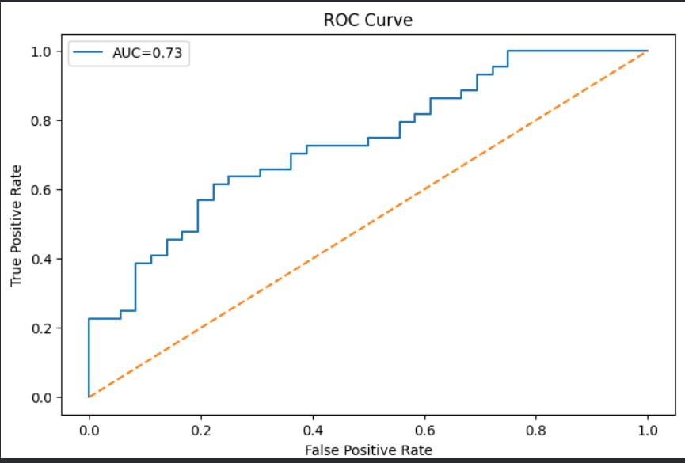
ROC Curve : - classification model performance evaluation

Slide 12
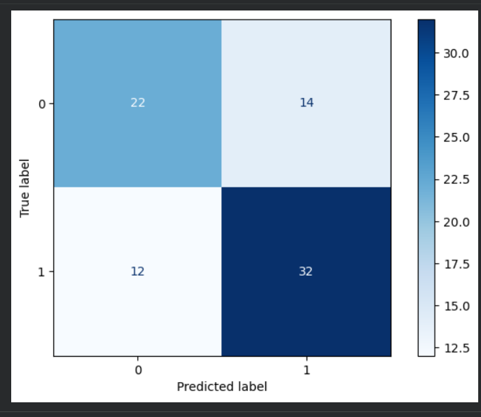
Confusion Matrix :- It used to evaluate predictions TP, TN, FP, FN

Slide 13
Conclusion
We developed a Heart Disease Detection System using classification algorithms, including Logistic Regression, K-Nearest Neighbors (KNN), Decision Tree, Random Forest, and Support Vector Machine (SVM), to predict the presence of heart disease from patient medical data. The project involved data loading, data exploration, data cleaning, exploratory data analysis (EDA), feature selection, feature scaling, and model training, followed by evaluation using performance metrics such as Accuracy, Precision, Recall, F1-Score, Confusion Matrix, Classification Report, and ROC Curve.
Overall, this project demonstrates a complete end-to-end machine learning workflow and highlights the potential of AI-based decision support systems for assisting healthcare professionals in the early detection of heart disease.

Slide 14
THANK YOU !

